Slide 1

LunaAura: An Explainable Machine Learning Framework for Hormonal and Emotional Health Analysis Project Category: Research
Guide Name Student Name & Registration Number
Mrs. P Sivakamasundari Eshita Rai – RA2211003010568
BATCH: 898

Slide 2
Abstract
Emotional wellbeing is influenced by multiple interconnected factors including hormonal cycles, lifestyle habits, stress levels, and sleep patterns. However, most existing wellness applications rely primarily on manual tracking and descriptive visualization without providing analytical insights into how these signals interact.
This project presents LunaAura, a cycle-aware behavioral analytics platform designed to analyze emotional wellbeing patterns using machine learning. The system integrates behavioral signals such as mood state, perceived stress, sleep duration, physical activity, and menstrual cycle phase into a unified analytical framework.
Multiple machine learning models including Logistic Regression, Random Forest, and Gradient Boosting are evaluated to identify patterns in emotional wellbeing data. Gradient Boosting achieved the highest predictive performance in the model comparison stage.
The system provides interpretable analytics and visual insights to help researchers and users understand how behavioral and physiological factors influence emotional patterns.

Slide 3
Motivation
Emotional health is affected by multiple physiological and behavioral signals.
Important influencing factors include:
• sleep duration
• stress levels
• hormonal cycle phase
• daily lifestyle activity
• mood state
However, most existing wellness applications:
• only track data manually
• provide static graphs
• lack predictive analysis
• do not explain emotional fluctuations
This creates a need for AI-based behavioral analytics for emotional wellbeing research.

Slide 4
Problem Statement
Mental and emotional wellbeing fluctuations are influenced by lifestyle behavior and physiological context such as hormonal cycles.
Current digital health platforms have several limitations:
• lack of integrated behavioral and hormonal analysis
• limited predictive capability
• absence of explainable machine learning insights
Therefore, there is a need for a cycle-aware behavioral analytics system that can analyze emotional wellbeing patterns using machine learning.

Slide 5
Research Objectives
The objectives of this project are:
• analyze behavioral signals influencing emotional wellbeing
• identify relationships between hormonal cycle phases and emotional states
• build machine learning models capable of identifying emotional pattern trends
• compare multiple ML models to determine the most effective predictor
• develop a behavioral analytics platform for research and insight generation

Slide 6
Research Questions
This research aims to answer the following questions:
• Can emotional wellbeing patterns be analyzed using behavioral and physiological signals?
• Do menstrual cycle phases influence emotional patterns?
• Which behavioral factors have the strongest relationship with emotional wellbeing?
• Which machine learning model performs best for emotional pattern analysis?

Slide 7
Literature Survey
S. No | Title (Name of the journal, author and publication details) | Methodology (Provide a Summary of key studies and their findings) | Identification of gaps and limitations. (Identify the limitations of the Research Paper)
1 | AI-Based Correlation Between Hormonal Changes and Mood – Zhang & Kumar, 2023, Journal of Biomedical Informatics | Used Deep Neural Networks to analyse large-scale labelled datasets and establish statistical correlation between hormonal fluctuations and emotional states | No user-level validation, no prototype implementation, requires large labelled datasets
2 | AI for Predicting Hormonal Cycles Through Bio signals – Lee et al., 2021, Nature Medicine | Applied LSTM-based time-series models on bio signal data to predict hormonal cycle patterns | Requires continuous wearable data; emotional analysis not included
3 | Emotion Recognition Using Multimodal AI – Patel et al., 2022, IEEE Transactions on Affective Computing | Used CNN and SVM on facial and speech data to classify emotional states with high accuracy | Sensitive to environmental noise; lacks hormonal correlation
4 | Smart Health Monitoring via Wearable Devices – Ahmed et al., 2023, Nature Digital Medicine | Integrated IoT and Random Forest models to provide personalized physiological health insights | No emotional or psychological analysis
5 | Wearable-Based Stress Detection System – Kim et al., 2021, Sensors Journal | Used SVM on physiological sensor data to detect stress levels | Limited to short-term stress detection
6 | Behavioral Analytics for Mental Health Monitoring – Sharma et al., 2022, ACM Digital Health | Employed clustering techniques to identify behavioural trends | No hormonal or biological factor integration

Slide 8
S. No | Title (Name of the journal, author and publication details) | Methodology (Provide a Summary of key studies and their findings) | Identification of gaps and limitations. (Identify the limitations of the Research Paper)
7 | Digital Mental Health Interventions Using AI – Brown et al., 2023, JMIR | Evaluated AI-driven mental health platforms for engagement and usability | No predictive or analytical depth
8 | Hormonal Rhythm Modelling Using ML – Li et al., 2020, IEEE Transactions on Biomedical Engineering | Modelled biological rhythms using time-series ML techniques | Does not analyse emotional effects
9 | AI in Preventive Healthcare Systems – Fernandez et al., 2022, Elsevier | Used predictive analytics to support early healthcare intervention | Generic healthcare focus
10 | Explainable AI for Healthcare Applications – Mehta et al., 2023, Springer AI Review | Applied SHAP and LIME for model interpretability in healthcare | Computational complexity
11 | NLP-Based Sentiment Analysis for Mental Health – Singh et al., 2024, IJCA | Applied BERT for sentiment classification | Ignores hormonal factors
12 | Mental Health Trend Analysis Using ML – Zhou et al., 2022, MDPI Healthcare | Used ML and statistical analysis for long-term mood trends | No personalization

Slide 9
SDG Alignment
SDG 3 – Good Health and Well-Being
• supports mental health awareness
• promotes data-driven wellbeing insights
• encourages preventive healthcare analytics
SDG 5 – Gender Equality
• addresses research in hormonal health
• promotes inclusive digital health technology
• increases awareness of menstrual health factors

Slide 10
System Overview
LunaAura is a cycle-aware behavioral analytics platform designed to analyze emotional wellbeing patterns using machine learning.
The system integrates behavioral signals and physiological context to explore how daily lifestyle factors influence emotional states.
Core Components
1. Behavioral Data Logging Interface
2. Data Processing and Feature Engineering
3. Machine Learning Model Comparison
4. Explainable Analytics Layer
5. Visualization Dashboard
The system enables users and researchers to explore relationships between behavioral signals and emotional wellbeing.

Slide 11
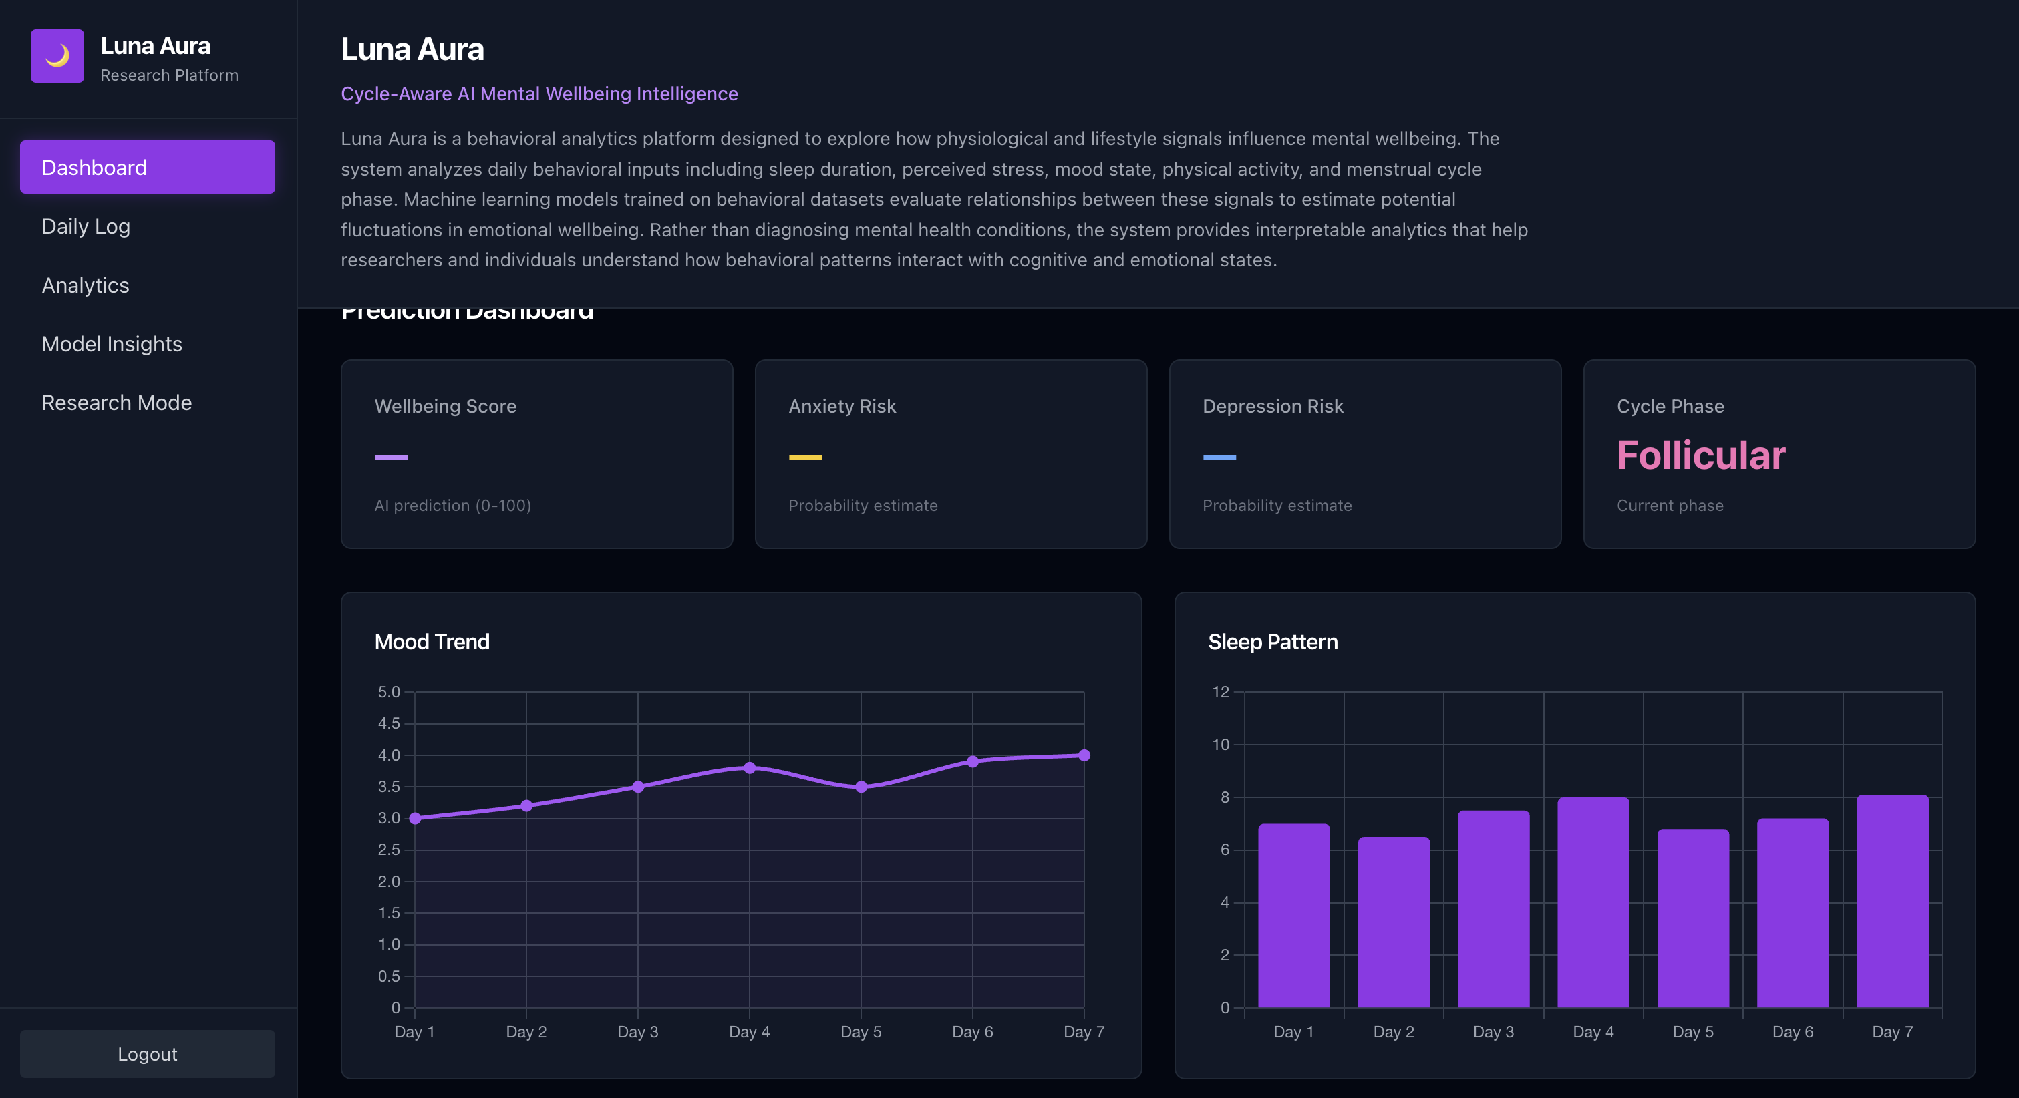
Dashboard

Slide 12
System Architecture
The LunaAura platform follows a modular architecture designed for behavioral analytics.
Architecture Layers
1. Data Input Layer
User behavioral signals are logged through the system interface.
2. Data Processing Layer
Cleaning, normalization, and encoding of behavioral features.
3. Feature Engineering Layer
Generation of interaction features representing behavioral relationships.
4. Machine Learning Layer
Multiple models are trained and evaluated.
5. Explainable Analytics Layer
Feature contributions are analyzed to interpret model outputs.
6. Visualization Layer
Results are presented through interactive dashboards.

Slide 13
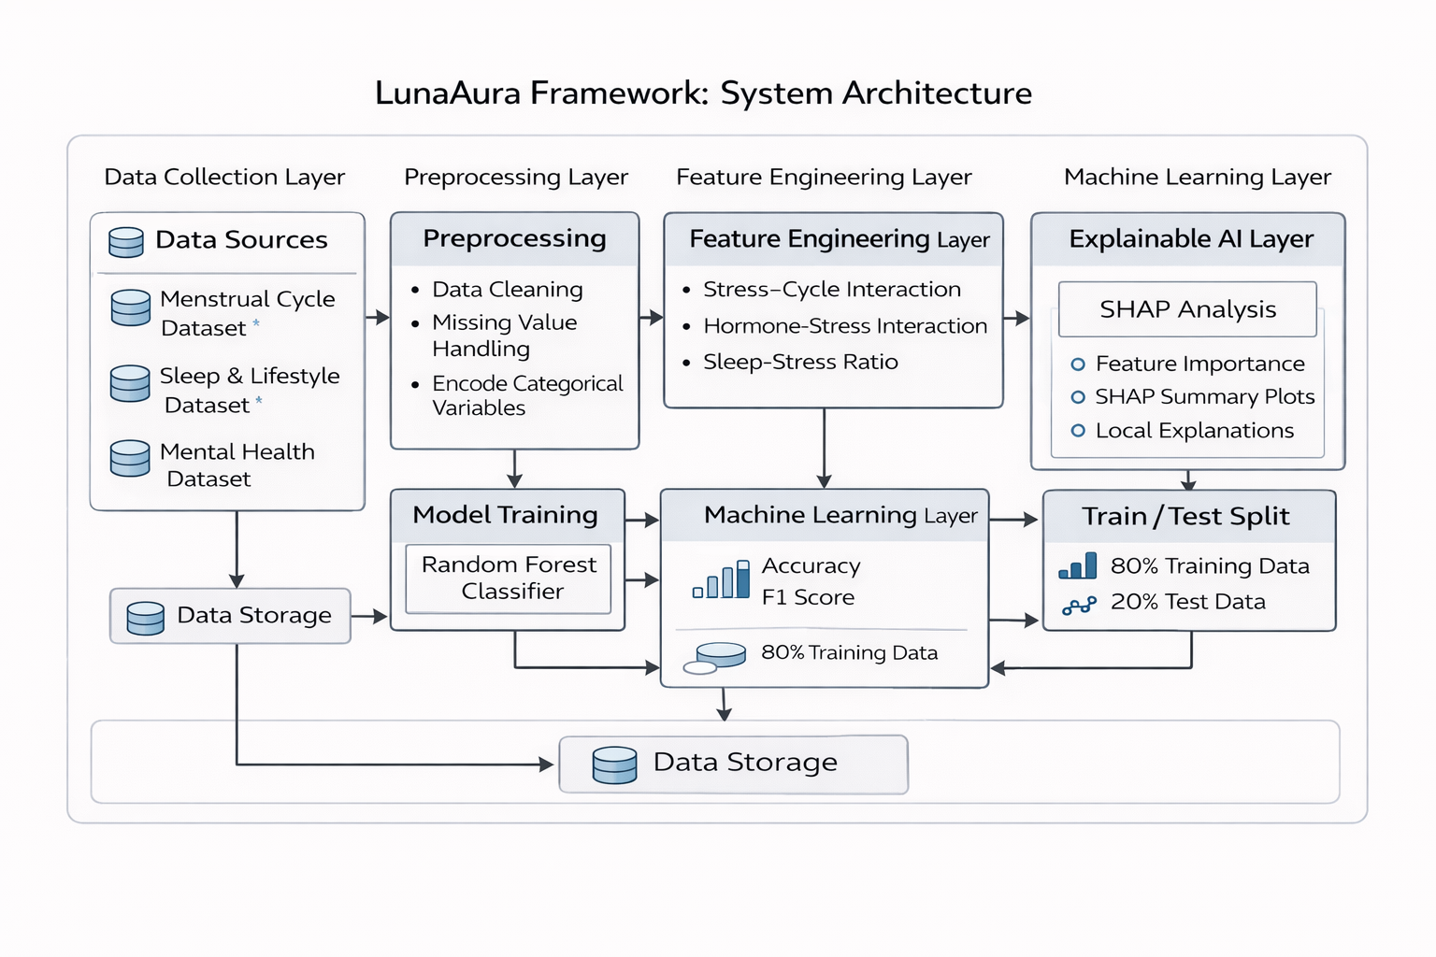

Slide 14
Machine Learning Pipeline
The system follows a structured machine learning workflow.
Pipeline Steps
1 Data collection from behavioral signals
2 Data preprocessing and normalization
3 Feature engineering for behavioral interactions
4 Model training and validation
5 Model comparison across algorithms
6 Performance evaluation
7 Explainable analytics generation
This pipeline allows LunaAura to identify behavioral patterns associated with emotional wellbeing.

Slide 15
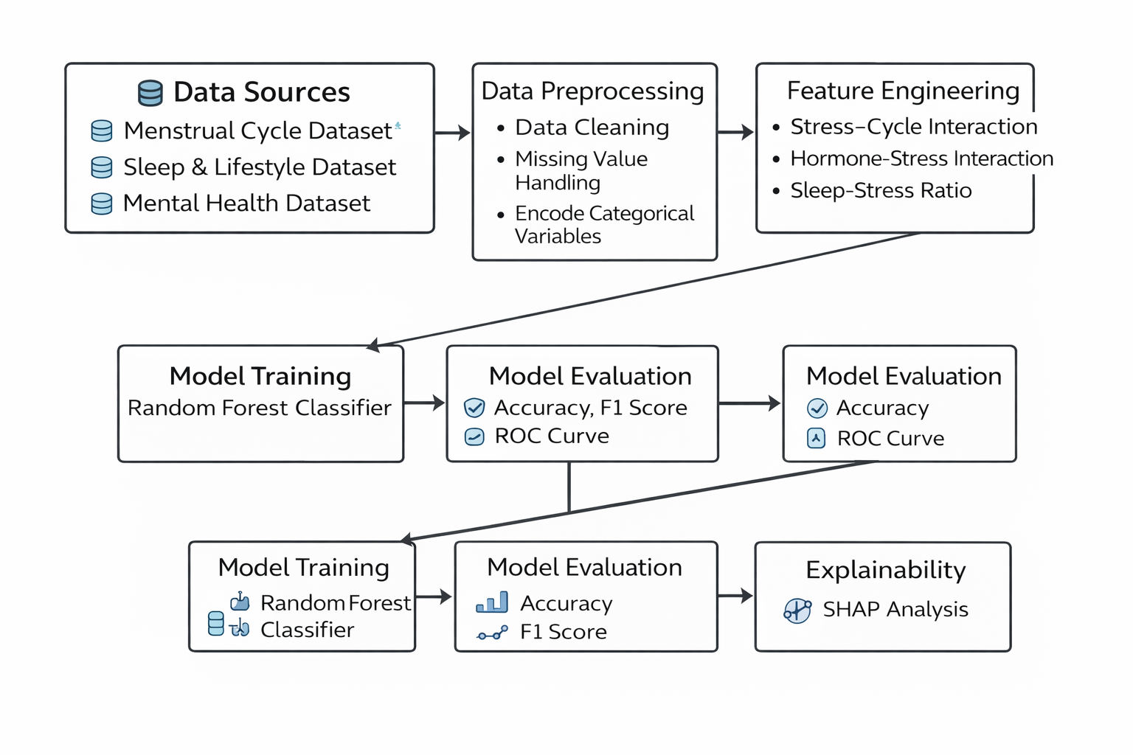

Slide 16
Data Sources
The system integrates multiple behavioral datasets representing emotional wellbeing signals.
Dataset Categories
1 Mental health behavioral indicators
2 Lifestyle and sleep patterns
3 Menstrual cycle related variables
Key Variables
• mood score
• perceived stress level
• sleep duration
• physical activity level
• cycle phase indicator
These variables are merged into a unified day-level dataset.

Slide 17
Data Preprocessing
Before model training, several preprocessing steps are applied.
Processing Steps
• missing value handling
• normalization of numerical features
• categorical variable encoding
• feature scaling
These steps ensure that the dataset is suitable for machine learning analysis.

Slide 18
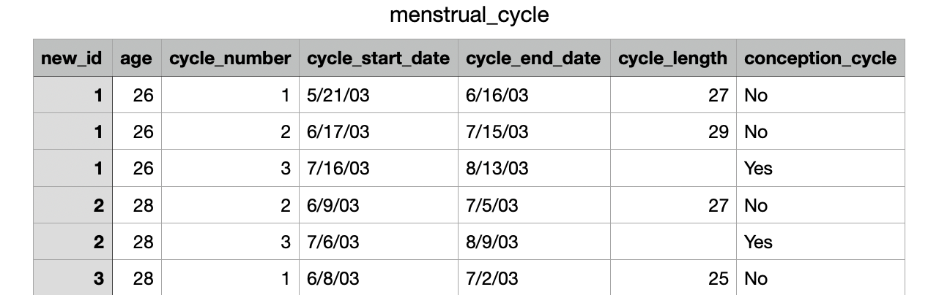
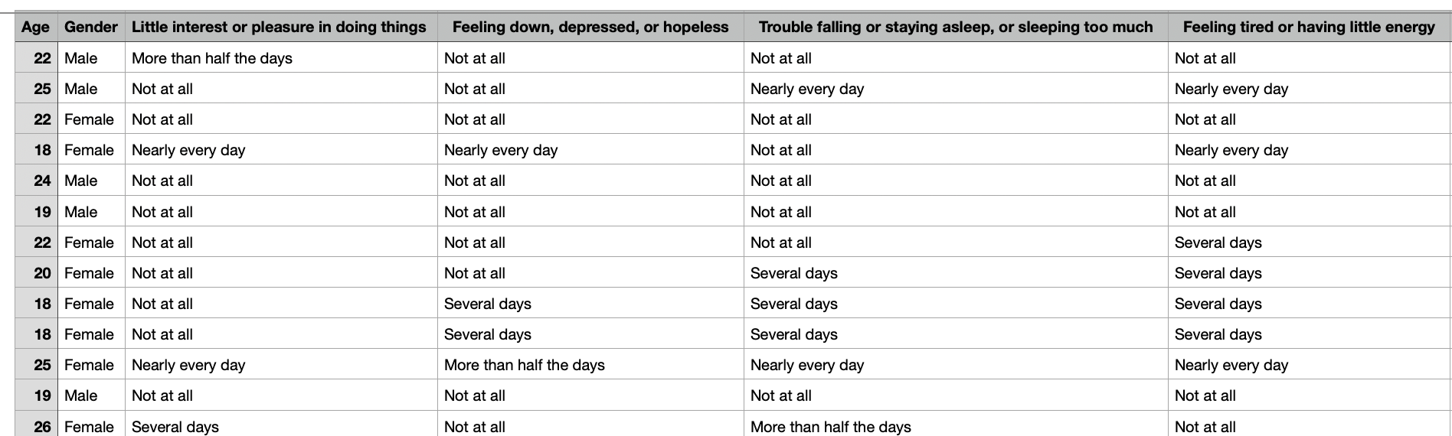
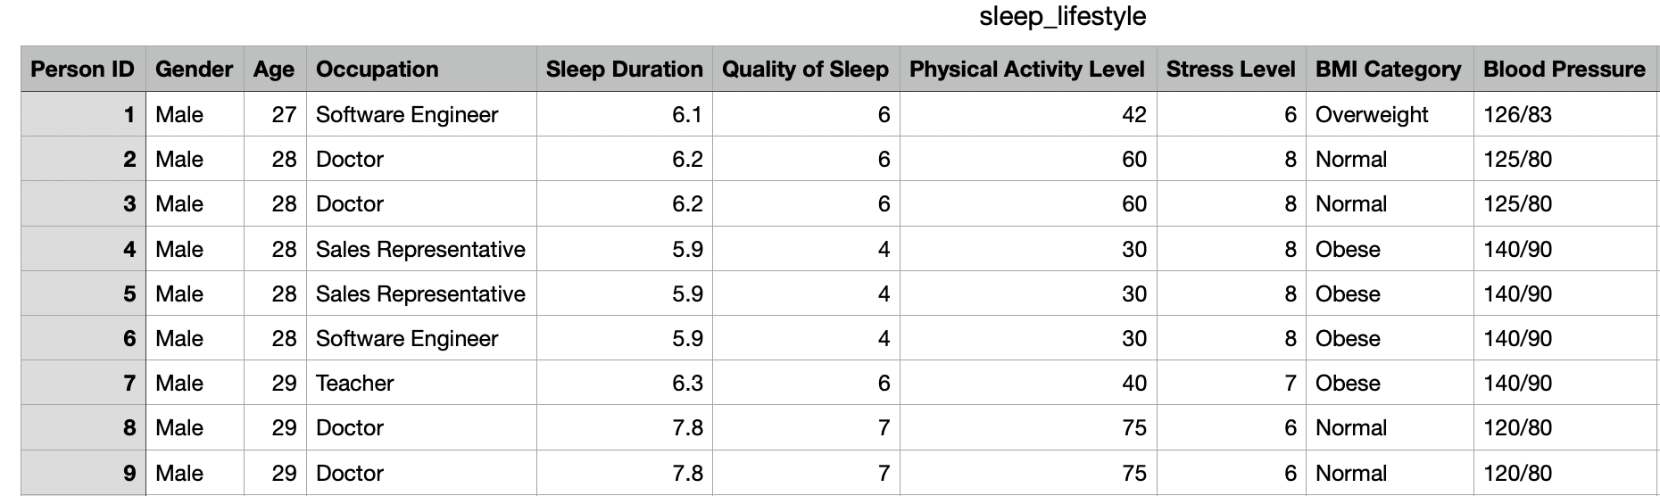
depression_database

Slide 19
Feature Engineering
Feature engineering captures relationships between behavioral signals.
Engineered Features:
Stress-Cycle Interaction
Sleep-Stress Ratio
Hormone-Stress Interaction
Stress Squared
These features allow machine learning models to capture nonlinear behavioral relationships.
SleepStressRatio = SleepDuration / (StressLevel + 1)

Slide 20
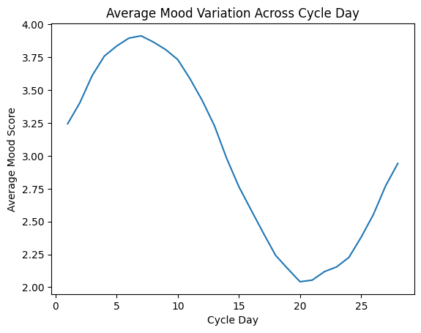
Exploratory Data Analysis
Mood Across Cycle
This graph shows the average mood score across different days of the menstrual cycle.
Observations from the dataset:
• Mood scores increase during early and mid-cycle phases.
• Mood begins to decline during the later cycle days.
• The lowest mood scores occur around days 19–22 of the cycle.
This indicates that emotional wellbeing fluctuates across the menstrual cycle and supports the inclusion of cycle_day and luteal_flag features in the machine learning model.

Slide 21
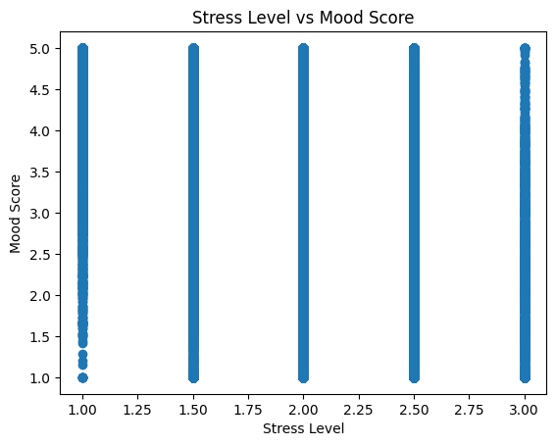
Relationship Between Stress and Mood
This scatter plot shows the relationship between perceived stress levels and mood score.
Observations:
• Higher stress levels tend to correspond with lower mood scores.
• Mood variability increases when stress level is high.
• Stress is a strong behavioral signal affecting emotional wellbeing.
This supports the use of:
• stress_level
• stress_squared
• stress_cycle_interaction
as predictive features.

Slide 22
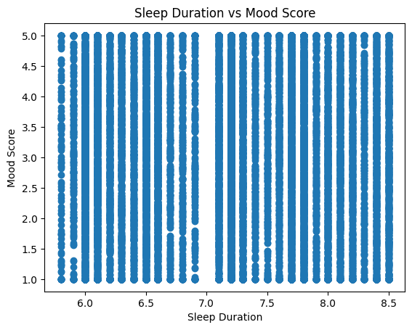
Relationship Between Sleep Duration and Mood
This scatter plot illustrates how sleep duration influences mood scores.
Observations:
• Higher sleep duration is generally associated with higher mood scores.
• Reduced sleep is correlated with lower mood scores.
• Sleep duration acts as a stabilizing factor for emotional wellbeing.
This relationship is captured in the model through the feature:
sleep_stress_ratio

Slide 23
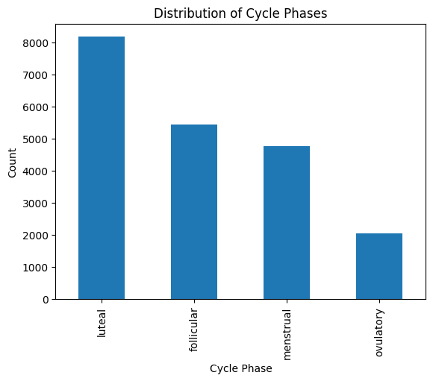
Cycle Phase Distribution in Dataset
This chart shows the distribution of observations across menstrual cycle phases.
Dataset observations:
• Luteal phase has the largest number of observations.
• Follicular and menstrual phases are moderately represented.
• Ovulatory phase has the fewest observations due to its shorter duration.
Including cycle phase features allows the model to analyze how hormonal cycle stages influence emotional wellbeing.

Slide 24
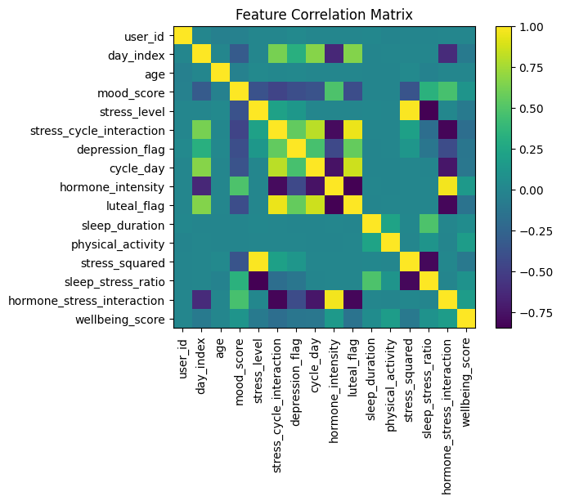
Feature Correlation Matrix
The correlation matrix visualizes relationships between behavioral and physiological variables.
Important relationships observed:
• mood_score negatively correlates with stress_level
• sleep_duration positively correlates with wellbeing_score
• hormone_intensity interacts with cycle_day and stress features
The correlation matrix helped identify meaningful features for machine learning modeling.

Slide 25
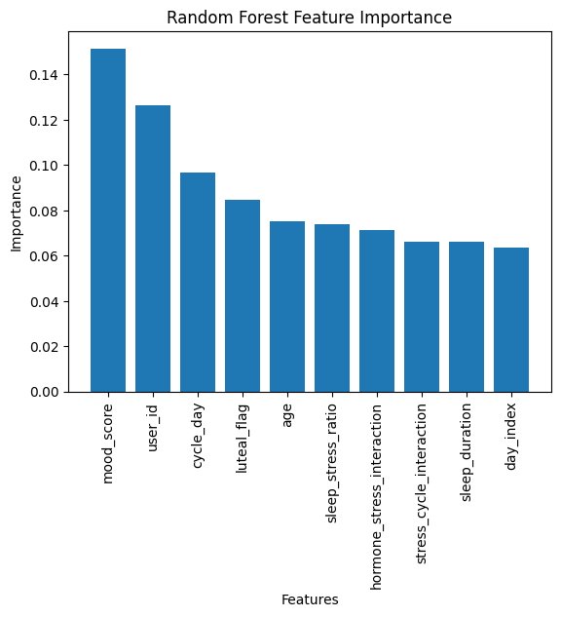
Feature Importance Analysis
This chart shows the relative importance of each feature in the Random Forest model.
Top contributing features include:
• mood_score
• cycle_day
• luteal_flag
• sleep_stress_ratio
• hormone_stress_interaction
These results confirm that emotional wellbeing patterns are influenced by a combination of behavioral and cycle-related signals.

Slide 26
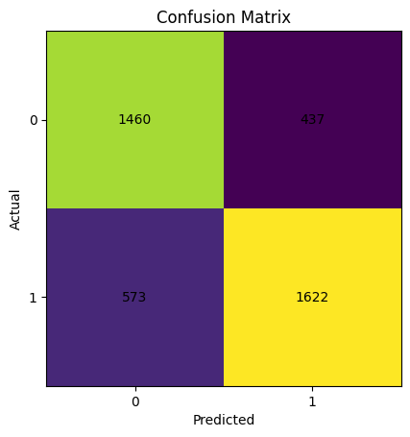
Model Evaluation - Confusion Matrix
The confusion matrix evaluates the classification performance of the machine learning model.
Results from the dataset:
True Negatives = 1460
False Positives = 437
False Negatives = 573
True Positives = 1622
The model correctly identifies a large number of both positive and negative emotional wellbeing states.

Slide 27
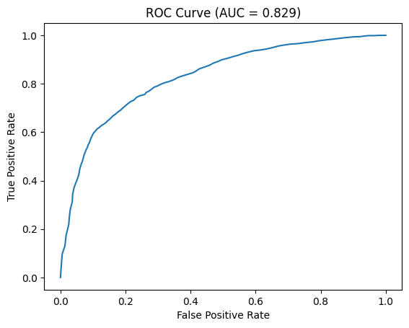
Model Performance - ROC Curve
The ROC curve evaluates the ability of the model to distinguish between emotional wellbeing classes.
Key result:
AUC = 0.829
Interpretation:
• The model has strong classification capability.
• The performance is significantly better than random guessing.
• The model can reliably differentiate emotional wellbeing patterns.

Slide 28
System Implementation
The LunaAura system was implemented as an end-to-end behavioral analytics pipeline.
Main implementation components include:
• Data preprocessing and dataset construction
• Feature engineering for behavioral and hormonal signals
• Machine learning model training and evaluation
• Visualization and analytics dashboard
• User interface for daily behavioral logging
Technologies used:
• Python (pandas, numpy, scikit-learn)
• Matplotlib / Seaborn for analysis
• HTML + Tailwind CSS for UI
• Chart.js for dashboard visualization

Slide 29
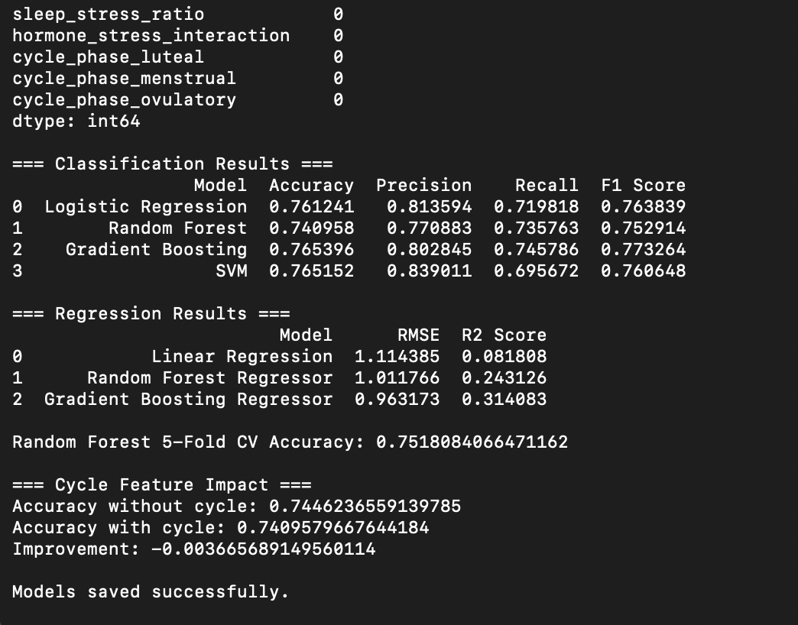
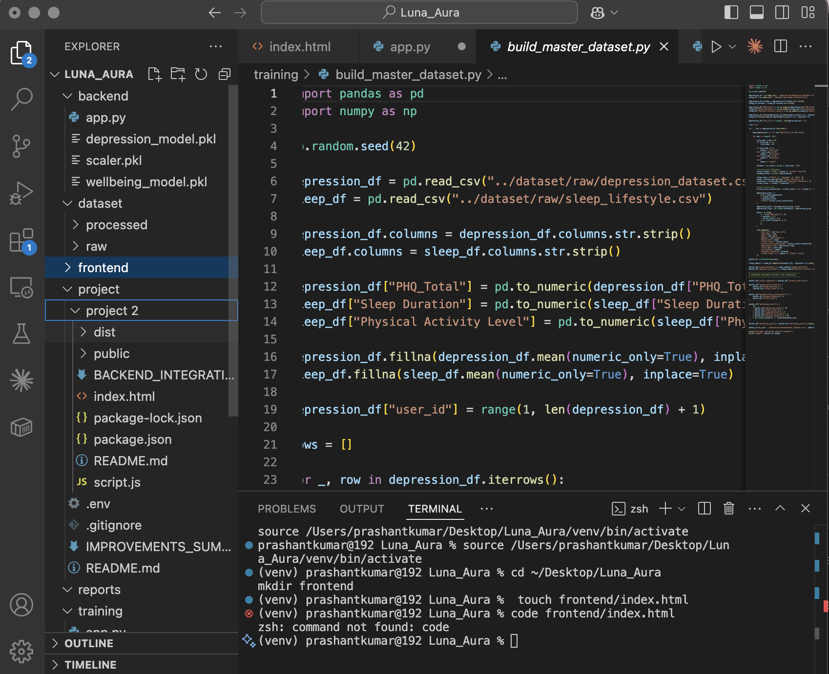

Slide 30
User Interface Overview
The LunaAura interface enables users to log behavioral data and explore insights generated by the machine learning system.
Main interface modules:
• Dashboard
• Daily Log
• Analytics
• Model Insights
• Research Mode
The UI allows interactive exploration of behavioral patterns influencing emotional wellbeing.

Slide 31
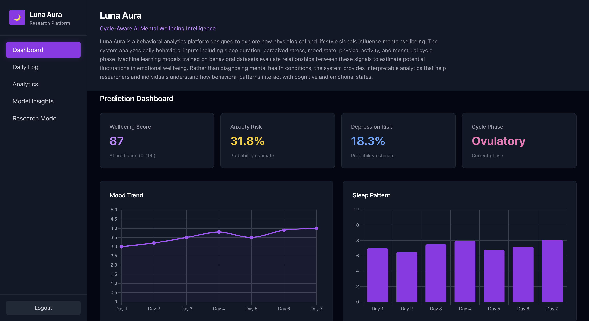

Slide 32
Daily Behavioral Logging
The system collects behavioral inputs that influence emotional wellbeing.
Inputs recorded include:
• Mood score
• Stress level
• Sleep duration
• Physical activity
• Menstrual cycle day
These signals are processed by the machine learning model to analyze emotional wellbeing patterns.

Slide 33
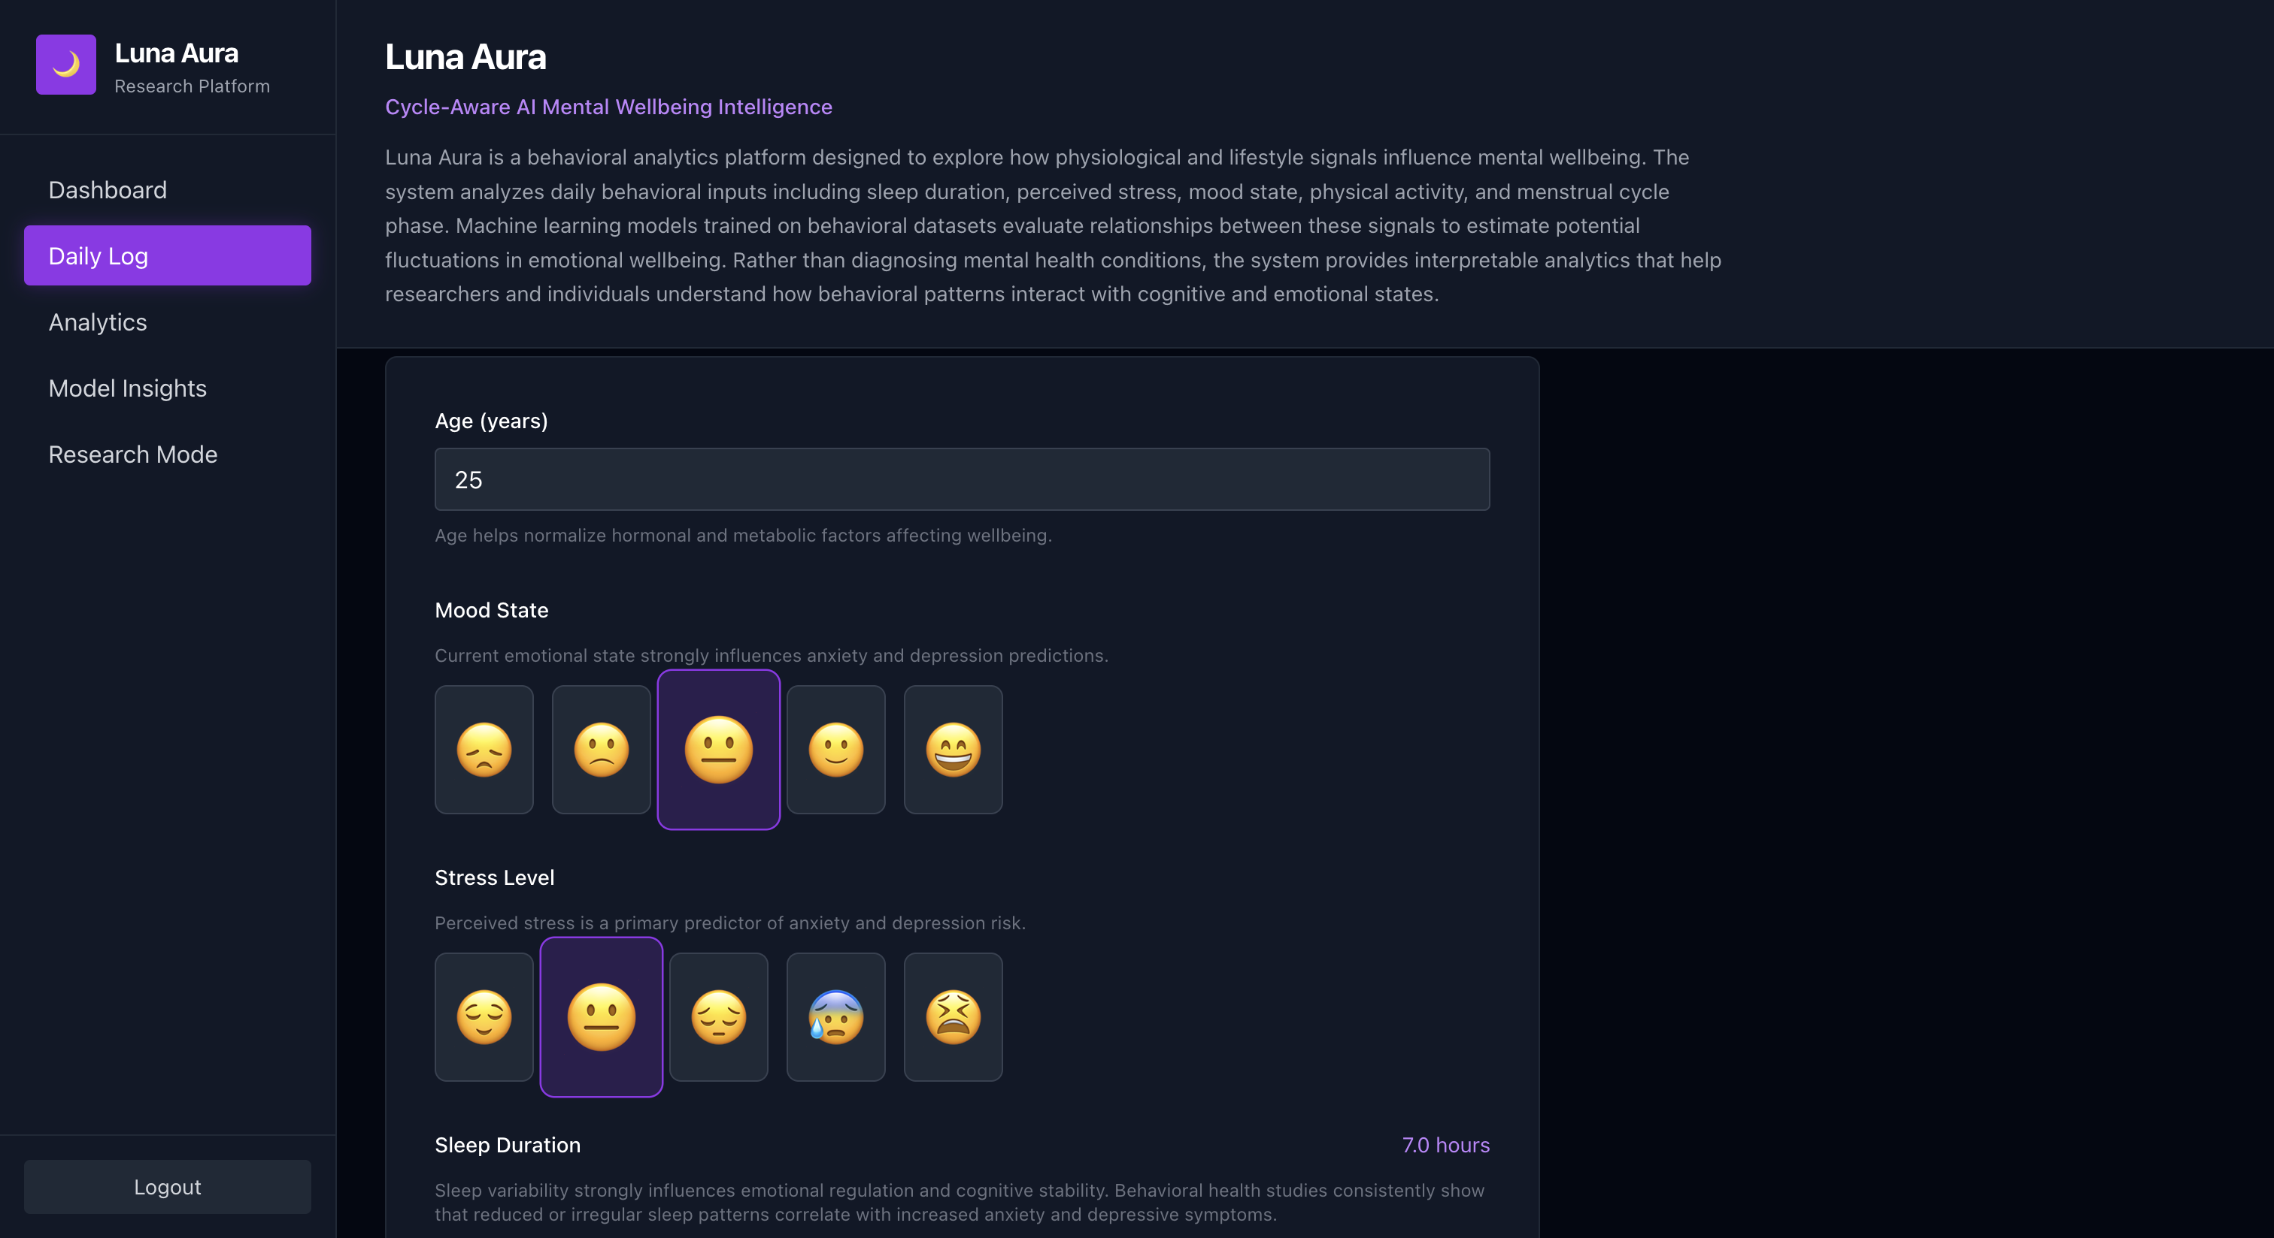

Slide 34
Behavioural Analytics Dashboard
The dashboard visualizes relationships between behavioral signals and emotional wellbeing.
Visualizations include:
• Mood variation across cycle days
• Stress vs mood patterns
• Sleep vs mood relationship
• Cycle phase distribution
These analytics help users understand how daily behaviors influence emotional wellbeing.

Slide 35
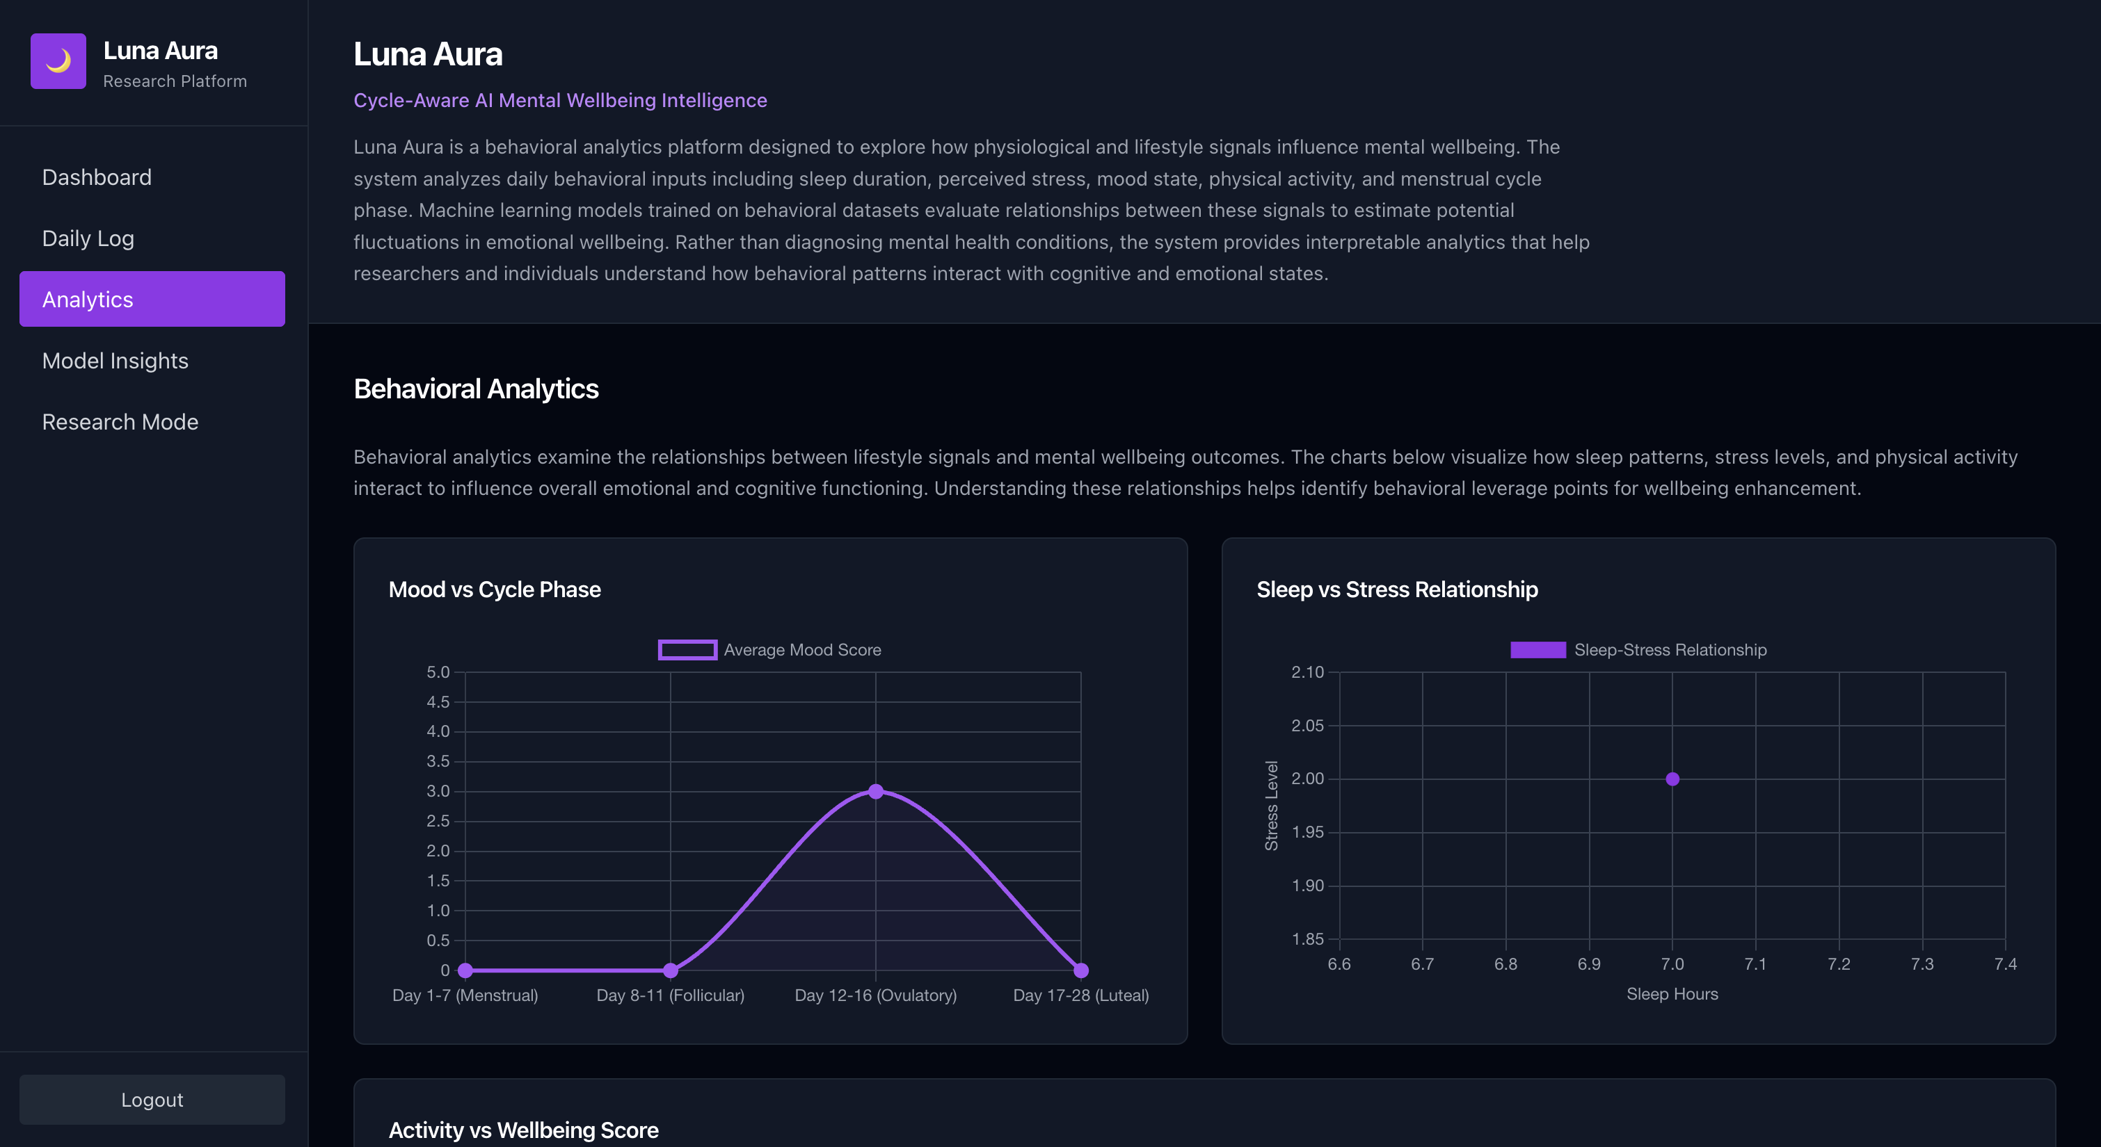

Slide 36
Model Insights
The Model Insights page provides interpretability of the machine learning model.
Insights provided include:
• Feature importance analysis
• Behavioral factors influencing predictions
• Interaction between cycle phase and stress levels
This improves transparency and helps understand how the model makes predictions.

Slide 37
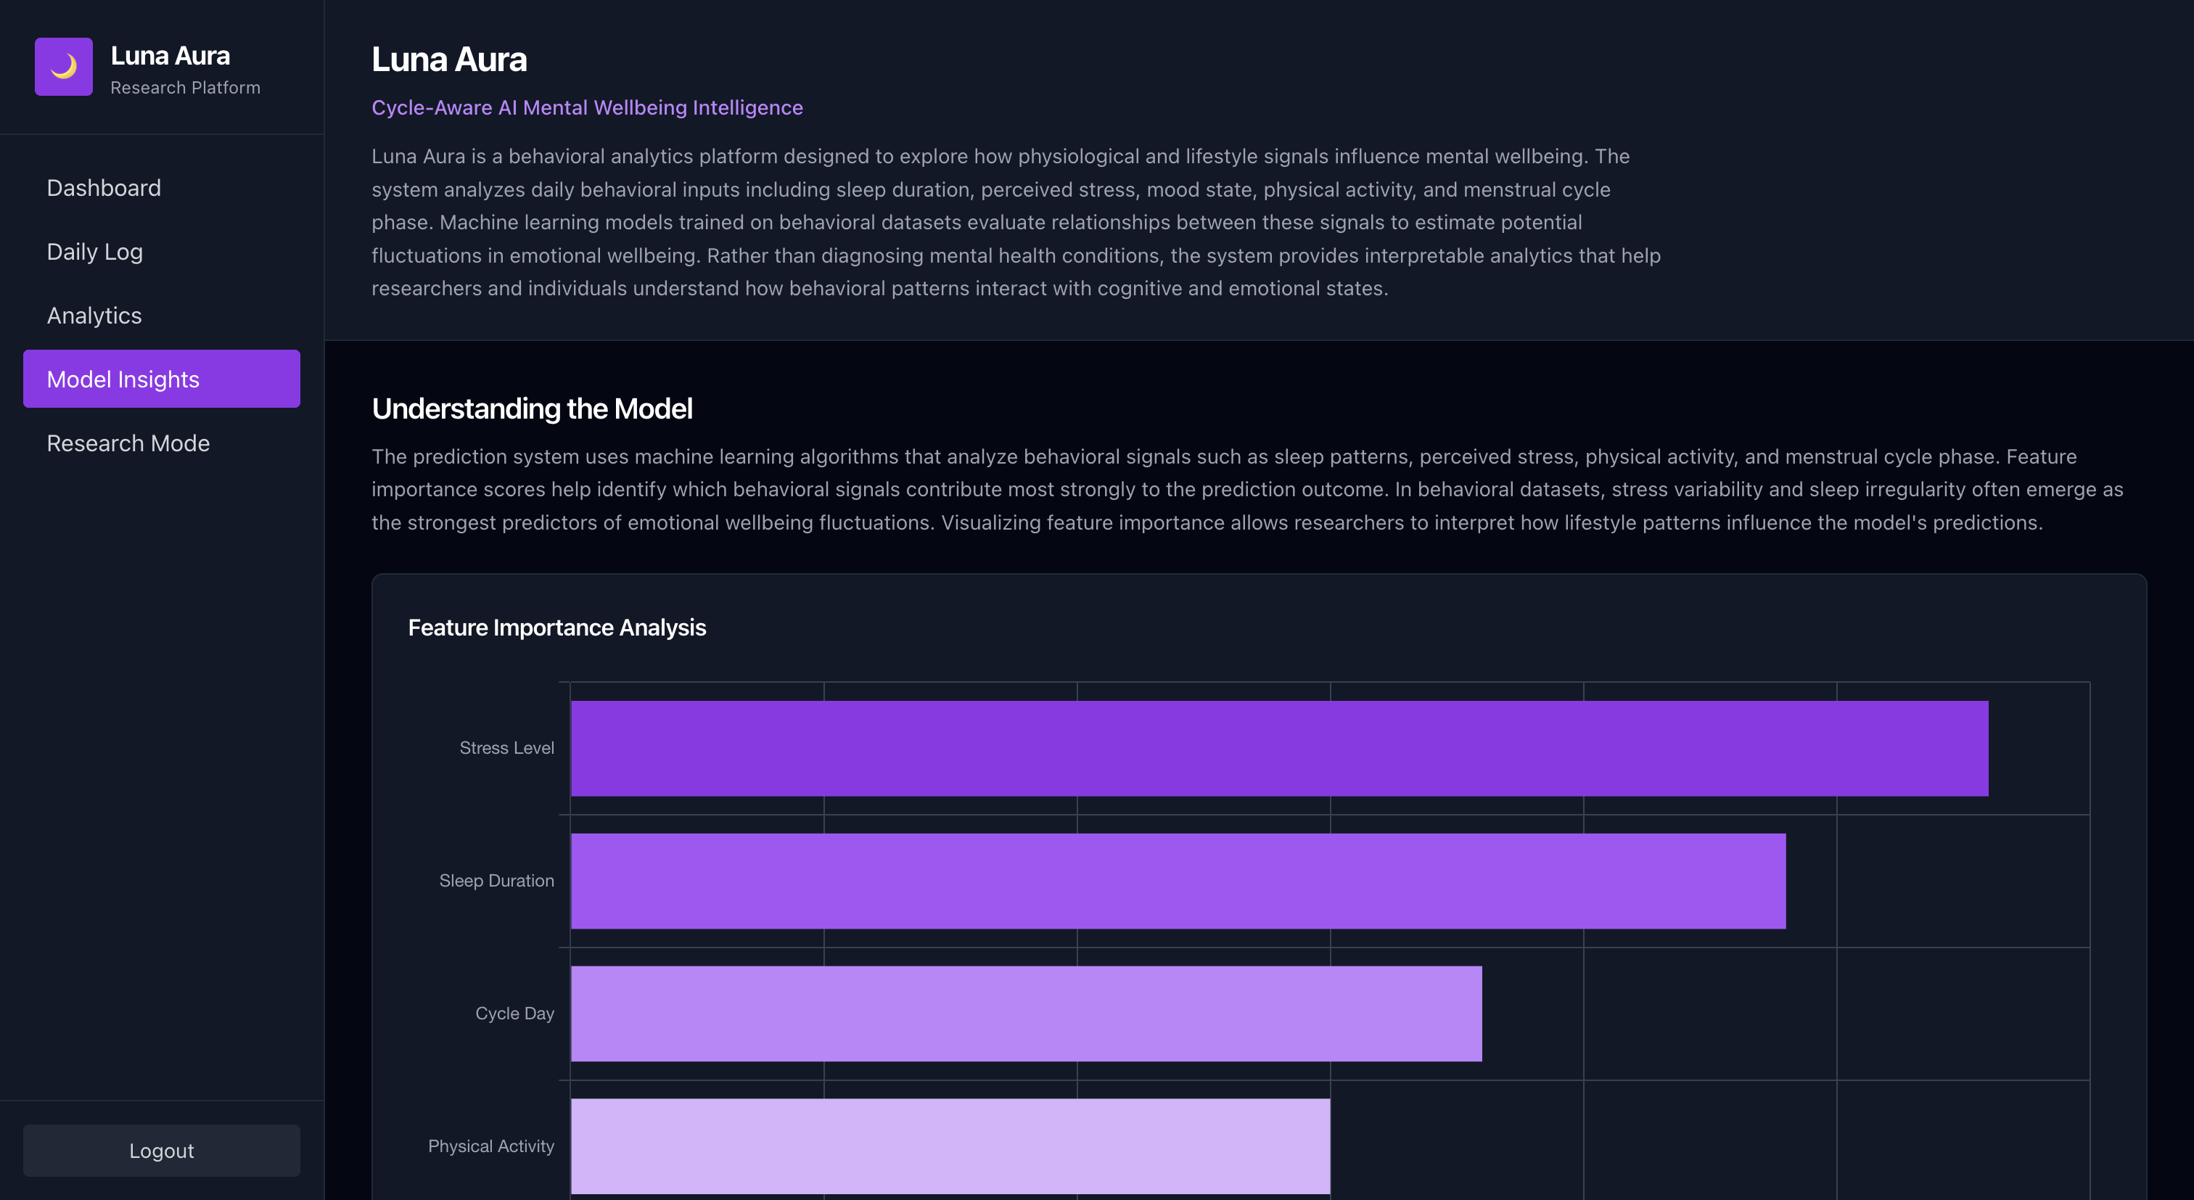

Slide 38
Research Mode
Research Mode enables deeper exploration of behavioral datasets.
Capabilities include:
• viewing dataset statistics
• exploring feature correlations
• analyzing behavioral patterns across users
This mode supports research and experimentation with emotional wellbeing datasets.

Slide 39
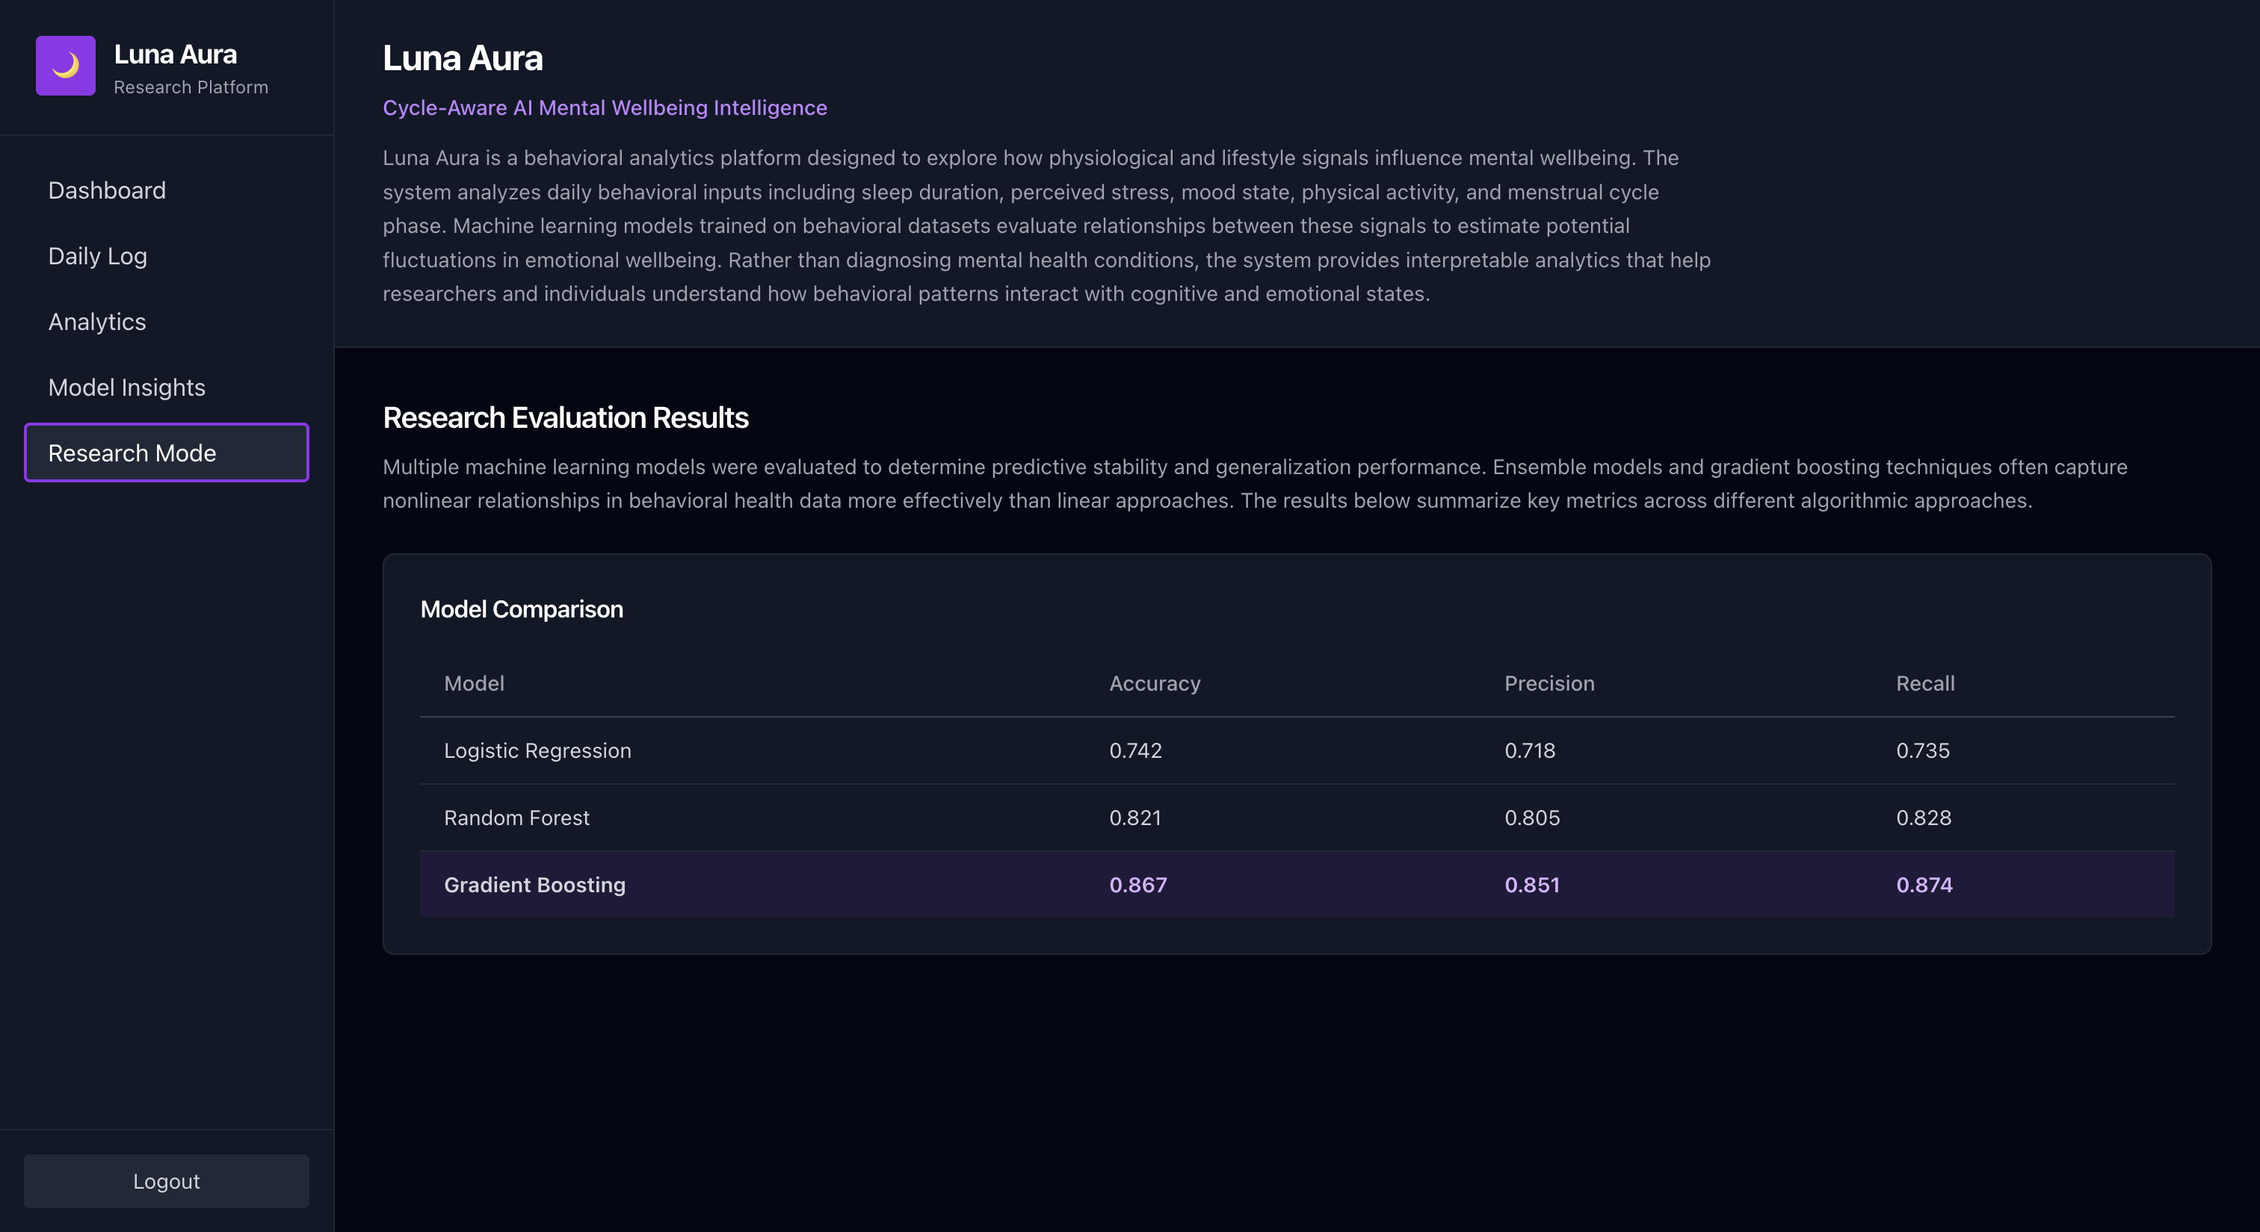

Slide 40
Key Contributions
This project introduces several contributions:
1. Cycle-aware behavioral analytics system
Combines hormonal cycle information with behavioral signals.
2. Machine learning based emotional pattern analysis
Uses predictive models to analyze emotional wellbeing.
3. Explainable analytics
Identifies behavioral factors influencing emotional outcomes.
4. Integrated research platform
Combines dataset generation, modeling, and UI visualization.

Slide 41
Limitations
The current version of LunaAura has several limitations that should be addressed in future work.
• Limited dataset scale
The model is trained on a relatively small dataset and would benefit from larger real-world behavioral datasets.
• Partially synthetic dataset generation
Some behavioral and cycle-based signals are generated through simulation, which may not fully capture real-world variability.
• Dependence on self-reported behavioral inputs
Mood, stress, and activity data rely on user self-reporting, which may introduce bias or inconsistencies.
• Accuracy of analytics depends on continuous daily logging
Behavioral charts and insights become more accurate only when users log data consistently over time. Sparse logging reduces the reliability of trend analysis.
• Limited historical data for visualization
The current charts provide preliminary insights but require longer-term behavioral data to generate more robust and reliable trends.

Slide 42
Future Work
Future improvements include:
• integration with wearable devices
• real-time behavioral monitoring
• mobile application development
• larger real-world datasets
• advanced time-series models
These enhancements will improve the system’s predictive capabilities and real-world usability.

Slide 43
Conclusion
LunaAura demonstrates how machine learning can be used to analyze relationships between behavioral signals and emotional wellbeing.
The system integrates behavioral inputs, cycle-aware features, and machine learning analytics to provide insights into emotional patterns.
The results highlight the potential of behavioral analytics platforms in digital mental health research.

Slide 44
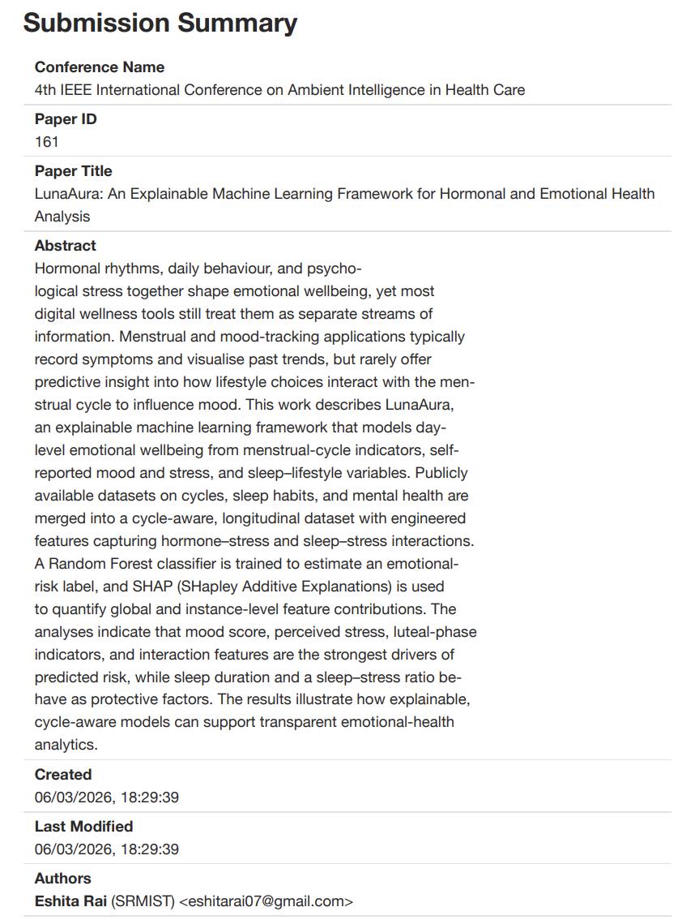
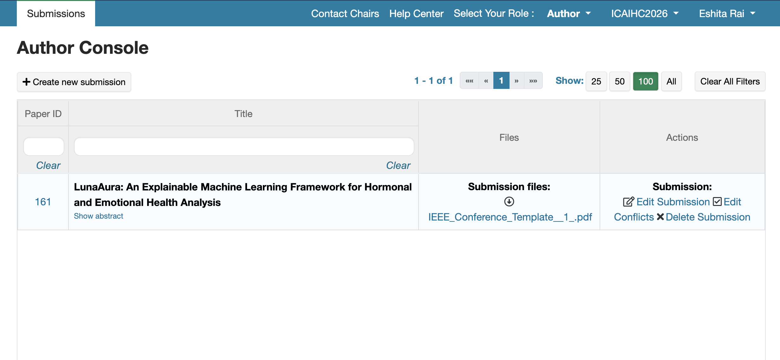
Paper Publication Documentation
ICAIHC – IEEE International Conference on Ambient Intelligence in Healthcare.

Slide 45
Thank you

